Slide 1

Healthcare Careers Pathways Program
Emergency Medical Technician Training Program
This project is funded by Senator Kenneth J. Donnelly Workforce Success Grant for Healthcare Workforce Hub through the Massachusetts Executive Office of Labor and Workforce Development and is administered by Commonwealth Corporation.

Slide 2
Overview
Healthcare Careers Pathways - Emergency Medical Technician Training Program
MassHire Hampden and Franklin Hampshire Workforce Boards will provide financial support to individuals interested in completing Emergency Medical Technician (EMTs) at local training institutions during a grant cycle of three years Jan 2024 – December 2026.
Job placement opportunities are available, once the trainee completes his/her national and state certification.
This program is not section 30 approved.

Slide 3
Grant Program Eligibility Requirements
Documentation of the participant’s employment status at the time of enrollment- OSCC
  Authorized to Work in US
    Birth Certificate or Driver license and SS# Card
  Proof of Unemployed
    Unemployed Benefits
    Letter from Employer
  Proof of Underemployed
    $17,881 for a family of one; (proof of income/income verification )
  If male- Selective Service – not required, but ideal for WIOA support service funds if needed
Completed & Signed Participant Registration Form (Hard Copy Only) OSCC
Signed Confidentiality Form (Hard Copy Only) OSCC

Slide 4
Grant Program Registration Process
Participants will connect with the training/employment program through the flyer
They will use the flyer link/QR code to register as interested candidate
Registration will be populated in a shared google sheet
  Career center assignments will be determined by the city the customer lives in. If customer is already in MOSES, the customer will be assigned to appropriate office.. New customers living in FH county will be referred to FHCC via email
  Upon completion of outreach, case manager will continue to update participant tracking sheet
Career Center staff will contact candidate with information on next steps, discuss and review eligibility requirements
Candidate will attend information session and complete all program documentation
Career Center staff will submit required documentation to WB office using drop box
Candidate will select trainer
Career Center staff will inform trainer POC of candidate’s intention to apply for the training
Candidate will complete trainer specific registration process and receive confirmation of acceptance into the training program. (how)
Candidate will receive notification of acceptance into program, and commit to training and employment requirements. (who)
Candidate will attend MH program orientation

Slide 5
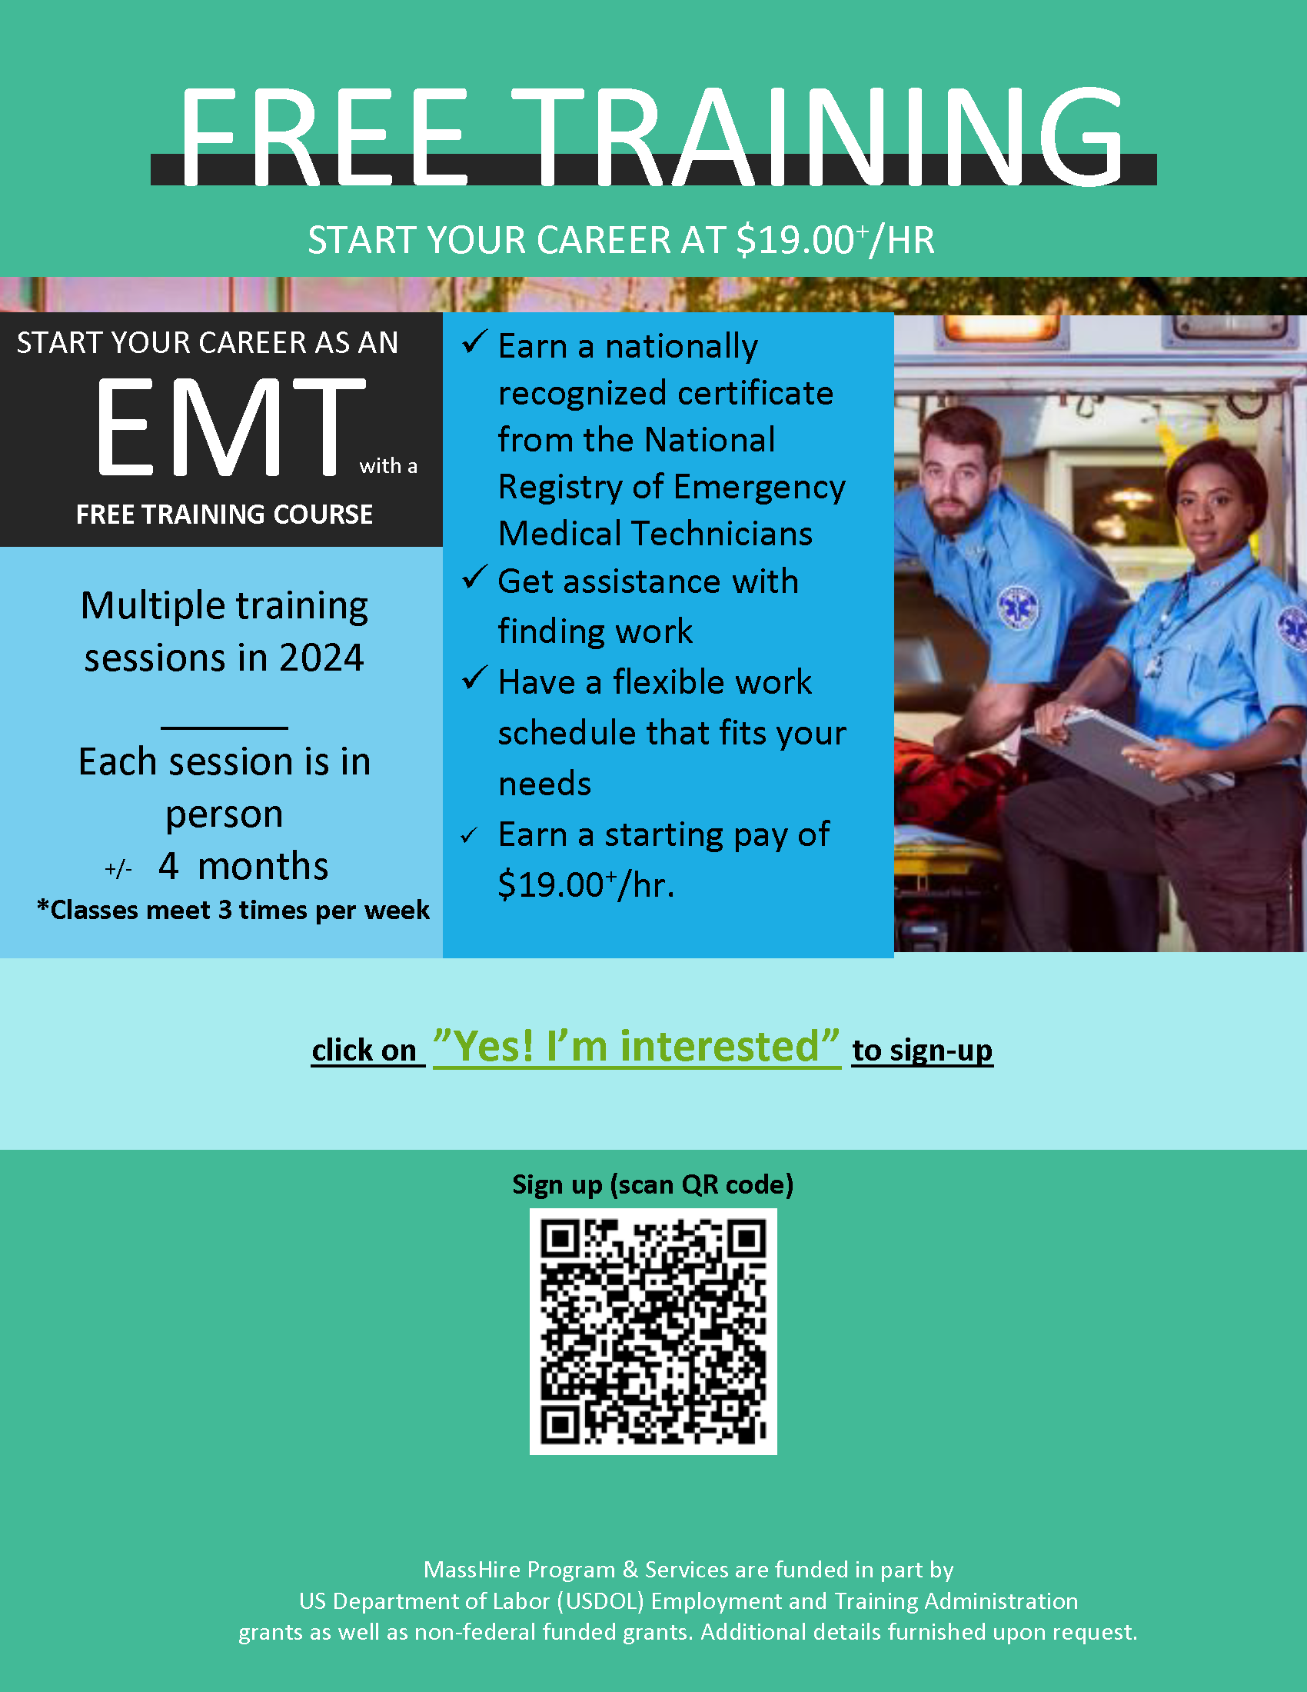
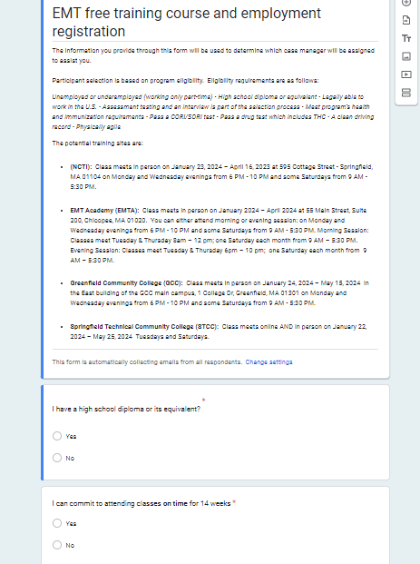
Grant Program Recruitment Plan
Coordination with MHHCWB, MHH, MHS and MHFH
5 HD Agency, Latino Marketing Team, MassHire Websites, resource rooms, libraries, workforce, partners, Cindy Gagnon at the MHHCC (marketing expert), shelters and work ready programs and other social media platforms
Youth Works Department
Training Institutions will also share opportunity with applicants
https://westernmasshealthcareers.org/
Flyer
Registration Form

Slide 6
Training Institution Options
(NCTI) * American Medical Response (AMR) affiliate
  Session Dates: January 23, 2024 – April 16, 2023
  Evening Session: Classes meet Tuesday & Thursday 6pm – 10 pm; Saturdays from 9 AM – 5:30 PM
EMT Academy (EMTA) * National Ambulance affiliate
  View Session Dates and Times via Webpage
  https://emtacademy.org/index.php/apply-for-emt-program/
Greenfield Community College (GCC)
  View Session Dates and Times via Webpage
  https://www.gcc.mass.edu/ems/emt/
Springfield Technical Community College (STCC)
  View Session Dates and Times via Webpage
  https://www.stcc.edu/wdc/descriptions/wemt-001-emergency-medical-technician-emt/

Slide 7

Training Program Eligibility:
NCTI
Unemployed or Underemployed (working only part-time)
High School Diploma or equivalent
Legally able to work in the U.S.
NCTI will interview and assess each candidate before they are selected for the EMT program It is important for the student's success as an EMT student that they are ready for this class.
Each candidate takes an EMT Assessment test. The topics they are asked questions about are A&P, basic math, biology and self-assessment/personality questions. This assessment gives us a good idea of who is prepared to be successful in the program based on a minimum score. Pass a CORI/SORI test
Immunization records including COVID vaccine
Pass a drug test which includes Marijuana
Physically agile
Clean driving record (must have a valid drivers license with 3 or less infractions in a 3 year period and/or no DUI/OUI in the past 7 years)

Slide 8
Training Program Eligibility:
EMT Academy
Unemployed or Underemployed (working only part-time)
High School Diploma or equivalent
Legally able to work in the U.S.
Pass a CORI/SORI test (National Ambulance conducts the CORI/SORI, drug test after the 1st day of class)
Immunization records including COVID vaccine (can decline COVID and Flu Vaccine)
Pass a drug test which includes Marijuana
Physically agile (completed upon employment)
Clean driving record (must have a valid drivers license with 3 or less infractions in a 3 year period and/or no DUI/OUI in the past 7 years) (National Ambulance conducts the after the 1st day of class)
Stay and complete paperwork after orientation
WorkKeys Assessment

Slide 9
Training Program Eligibility:
Greenfield Community College
Pass a CORI/SORI test
Pass a drug test which includes Marijuana
Data facts for drug infractions
Physically agile
Clean driving record (must have a valid drivers license with 3 or less infractions in a 3 year period and/or no DUI/OUI in the past 7 years)

Slide 10
Training Program Eligibility:
Springfield Technical Community College
This is a Hybrid course (online learning with in person labs)
At least 18 years of age within 3 weeks of the class start date.
Students must have a valid email and regular access to a computer
Unemployed or Underemployed (working only part-time)
Legally able to work in the U.S.
Physically agile
Career center would share a copy of the WorkKeys Assessment with STCC
Not required for training but might be necessary for employment
High School Diploma or equivalent
Pass a CORI/SORI test
Immunization records including COVID vaccine
Pass a drug test which includes Marijuana
Clean driving record (must have a valid drivers license with 3 or less infractions in a 3 year period and/or no DUI/OUI in the past 7 years)
Health Requirement Checklist verify with STCC

Slide 11
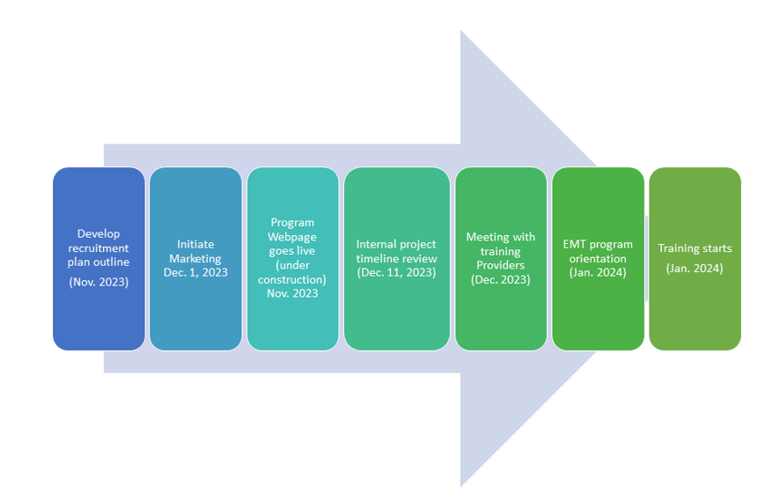
Program Overview

Slide 12
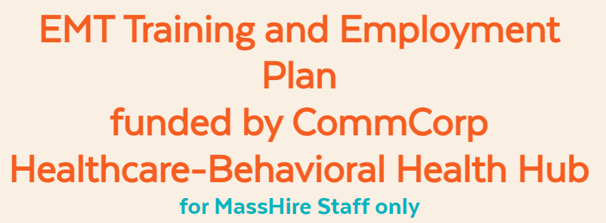
Stay Informed
Program Webpage (visit regular to view all program relation information
https://westernmasshealthcareers.org/emt-training-and-employment-plan-masshire/

